Slide 1
FY’26 Budget Presentation Two
Funding Formula & Tax Impact
December 17, 2024

Slide 2
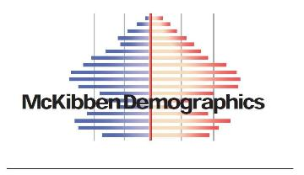
DISTRICT ENROLLMENT
Past and Future
2009 | 2,162
2012 | 2,144
2015 | 2,150
2018 | 2,106
2021 | 2,154
2024 Current | 2,202
2027 | 2,252
2030 | 2,303
2034 | 2,297

Slide 3
VERMONT
EDUCATION QUALITY STANDARDS
DAY 2
GRADES
K-3
GRADES
4-12
20 students per classroom
25 students per classroom
100 students per teacher
Notes:
Overall Numbers: K-2 = 19.5, 3-5=22, 6-8=21.25

Slide 4
FY26 Budget Development
Vermont’s education funding system is STATEWIDE.
Every District/SU in the state receives the funding they ask for
Money comes out of one fund at the state level
This fund is filled mainly by property taxes
Increased spending in other districts will influence Colchester’s tax bills
Tax rates are set to raise all the money needed to cover the cost of all the approved school budgets
Resources
a. VT Public Video explaining education finance
b. VT’s Education Funding System: Explained & Compared to Other States prepared by VT AOE

Slide 5
Education Funding Glossary of Terms
Education Spending
Total budget minus ‘non-tax revenues’ such as federal & state grants as well as locally-generated revenues such as tuition & interest
Long Term Weighted - Average Daily Membership (LTW ADM)
Two-Year Average Daily Membership (ADM - enrollment) adjusted by several factors such as preK (-0.54), middle 6-8 (.36) secondary 9-12 (.39), Poverty (1.03), & limited English proficiency (2.49)
Property Dollar Yield
Estimated amount districts have to spend per pupil to have an equalized tax rate
of $1.00 while generating enough money for the State’s Ed Fund
Good economy = higher yield, lower tax rates
Set by law (usually in late spring)
Common Level of Appraisal (CLA)
❖ Appraised value of property vs. market value
❖ Attempts to make tax bills “fair” across the State

Slide 6
Overview of Tax Commissioners Letter
Vermonters faced an increase of 14% in the statewide average property tax bill in FY’25.
The current projected average increase in statewide property taxes is 5.9%.
If the current tax increase assumption is accurate, Vermonters would have experienced a 33% increase in education property taxes from FY’23 to FY’26.
Total education spending is expected to increase from $1,880.6 million to $1,995.2 million (6.1% increase).
Average per pupil spending is expected to increase from $13,169 to $14,091 (7.0% increase).

Slide 7
Education Funding Changing
In FY25, Act 127 went into effect and changed the weighting for students. This brought a dynamic budget season and a mid-year change to the education funding formula through H850.
At the end of the session, when the Yield Bill (Act 183) passed, legislators also introduced a new methodology for the FY26 education funding property tax formula by including the concept of a new “statewide adjustment” to fundamental components of the formula (e.g. Yield, CLA).
Below are the values for the 3 primary financial components published in the 12/1 Letter. Due to the impact of the statewide adjustment, the letter states: “the homestead property yield and non-homestead rate forecast for FY26 are not directly comparable to the FY25 amounts.”
 | FY25 (reference) | FY26
Homestead Property Yield | $9,893 | $8,563
Income Yield | $10,110 | $12,260
Statewide Non-Homestead Property Rate | $1.391 | $1.791
Notes:
H850 - removed the tax cap and added the cent incentive
We are anticipating further changes to the yield and yet another change to the Vermont Education Funding Formula

Slide 8
FY26 Educational Tax Components
COMPONENT | SET BY | FY’26
Dollar Yield (set by legislature) | State | $8,553
Income Yield | State | $12,260
Estimated Ed Spending Increase $ | CSD | $6,077,977
Per Pupil Spending | CSD | $14,322
Common Level of Appraisal (CLA) | Town | 59%
Statewide Average CLA | State | 72%
Baseline Budget Increase $ | CSD | $6,975,673
Baseline Budget Increase % | CSD | 12.15%

Slide 9
Budget Drivers
Areas that have the greatest influence in increasing or decreasing the budget
Salaries and benefits
State mandated district contributions to employee health benefits is proposed to increase by 11.9%
Out of district placement
Professional education services
Food Service transfer
Transportation

Slide 10
Education Tax Calculation
Total Budget - Non-Tax Revenues = Education Spending
Education Spending / LTW ADM=Education Pending Per LTW ADM
Education Spending Per LTW ADM / Property Dollar Yield = Equalized Residential Tax Rate
Equalized Residential Tax Rate / Common Level of Appraisal (CLA) = Residential Tax Rate w/ CLA
Note: The dollar yield is set by the state and will change.

Slide 11
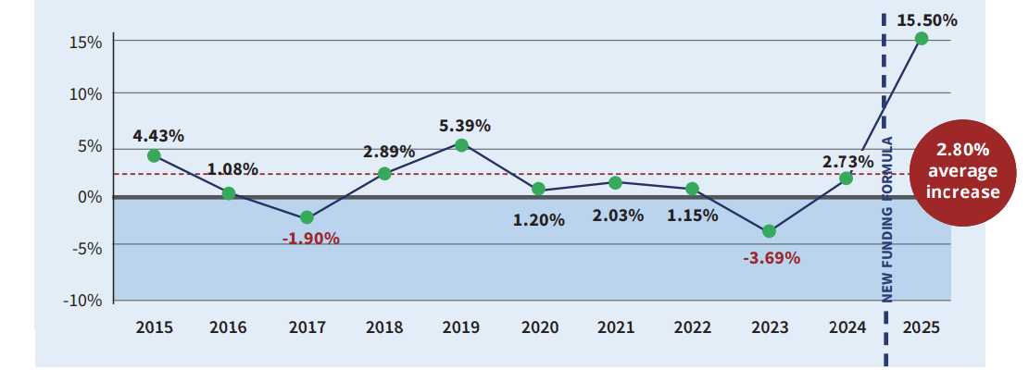
CSD Historical Tax Increases

Slide 12
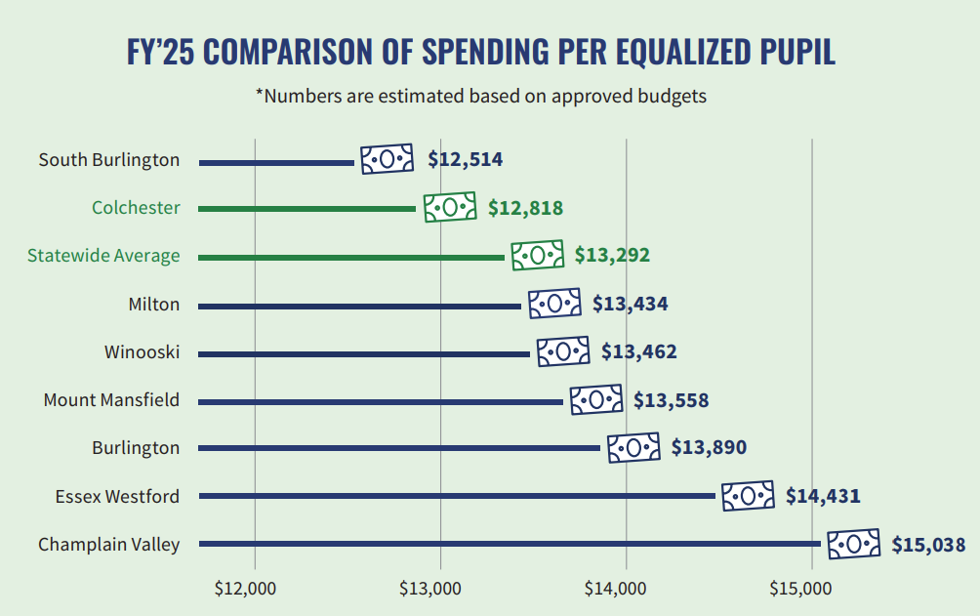
FY25 Comparison
Spending per Equalized Pupil

Slide 13
Administrative Priorities
Maintain resources effective for Multi-Tiered Systems of Support (MTSS) model in Academics, Social Emotional Learning and Inclusion.
Follow the class size guidelines in the VT Education Quality Standards
Early literacy and mathematics proficiency
Ensure continuation of co-curricular activities for students
Protect services dedicated to our most vulnerable students and families
Develop a budget that is fiscally responsible for tax payers
Explore all systems for efficiencies
Notes:
When I was in school, school were not build for ALL kids, we are tasked to educate all kids. When students belong, they are more likely to succeed. I want every students to leave CSD with the SKILLS and CONFIDENCE to may any choice they are faced with in life. As the world changes, so SHOULD schools. There is a frozen in time perception of what schools should be.

Slide 14
FY26 Budget Analysis
Highest Priority:
Maintain our existing levels of professional staffing
Areas we are monitoring:
Roof at MBS
Food services
Level of ML staffing
Size of current kindergarten class
179 students, average 22 per class, above EQS
Size of current grade 4 class
24 per class, only elementary grade with 7 teachers
Athletic funding at CMS and CHS
Champ Program at CHS
CMS new field hockey nets
Areas for Efficiency:
Full budget analysis
Software
Open positions
Notes:
Grade FOUR is 167 students with 8 teachers would be 21 per class, with 7 is 24 per class - EQS is 25

Slide 15
FY26 Budget Timeline
Discussion - What is the board’s goal regarding the tax implications of our budget?
When we bring back potential recommended budgets in January is there a target tax increase that the board would like to see?
What information does the board need as the budget process moves forward?
January 7th
January 14th
January 21st** - preferred date to warn
January 28th

Slide 16
Questions?

